Slide 1






DEVELOP INTERPRETIVE CONTENT FOR ECO-TOURISM ACTIVITIES
D2.TTO.CL4.07
Notes:
Trainer introduces the unit

Slide 2

Subject elements
This unit comprises three elements:
Research information
Prepare an eco-tourism activity
Update knowledge and ecotourism activities
Notes:
Trainer advises this Unit comprises three Elements, as listed on the slide explaining:
• Each Element comprises a number of Performance Criteria which will be identified throughout the class and explained in detail
• Trainees can obtain more detail from their Trainee Manual
• At times the course presents advice and information about various protocols but where their workplace requirements differ to what is presented, the workplace practices and standards, as well as policies and procedures must be observed.

Slide 3

Assessment
Assessment for this unit may include:
Oral questions
Written questions
Work projects
Workplace observation of practical skills
Practical exercises
Formal report from supervisor
Notes:
Trainer advises that assessment for this Unit may take several forms all of which are aimed at verifying they have achieved competency for the Unit as required.
Trainer indicates the methods of assessment that will be applied to them for this Unit.

Slide 4

Element 1:
Research information
Notes:
Introduce topic.
Class Activity – General Discussion
Ask general questions:
What does ‘interpretive content’ mean?
What does eco-tourism mean?
What types of eco-tourism exist in your region?

Slide 5

Research information
Performance Criteria for this Element are:
Describe the interpretive approach to guiding and activities
Identify sources of information for eco-tourism knowledge
Determine customer interests and potential themes for possible interpretive activities
Use research techniques to obtain information
Notes:
Trainer identifies the Performance Criteria for this Element, as listed on the slide.

Slide 6

Research information
Performance Criteria for this Element are:
Classify and store information
Verify information that has been gathered
Learn the required information to support identified eco-tourism concepts, themes and focal points
Notes:
Trainer identifies the Performance Criteria for this Element, as listed on the slide.

Slide 7
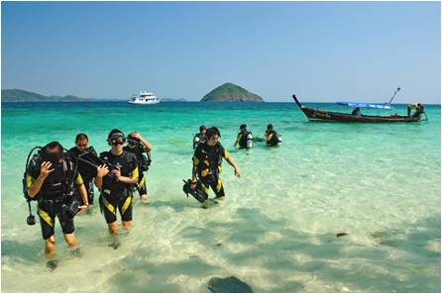
Interpretive guiding
Importance of interpretive guiding
Like in any tour, the need for interpretive guiding is essential to ensure a tour is:
Conducted in a professional manner
Full of interesting facts and activities
An enjoyable experience for the customer
Notes:
Discussion
Think back to a tour you have been a customer of in the past:
Did you enjoy it?
What made it enjoyable?

Slide 8

Interpretive guiding
Importance of interpretive guiding
Understanding the terms eco-tourism and the approach for an interpretive activity must be the starting point for identifying the basis for an interpretive activity.
What do these terms mean?
Notes:
Discussion
Discuss the question in the slide.

Slide 9

Eco-tourism
Definition of eco-tourism
In essence, ecotourism is a form of tourism involving visiting and understanding fragile, exotic, pristine, relatively undisturbed or threatened natural areas.
What are examples of eco-tourism in your region?
Notes:
Discussion
Discuss the question in the slide.

Slide 10
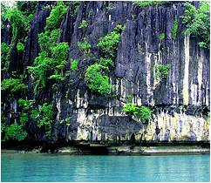
Eco-tourism
Common purposes of eco-tourism
Educate travelers
To provide funds for ecological conservation
To directly benefit the economic development and political empowerment of local communities
To generate respect for different cultures and for human rights.
Notes:
Discussion
What is the focus of eco-tourism?

Slide 11
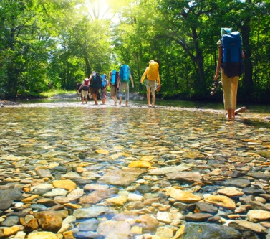
Interpretive guiding
Interpretive guiding
Interpretive guiding can be seen as the use of interpretive activities and presentation techniques by a tour guide when conducting a tour.
What are characteristics of interpretive guiding?
Notes:
Discussion
Discuss the question in the slide.

Slide 12

Interpretive techniques
Interpretive techniques
Interpretive techniques are ways of communicating information to visitors.
Interpretive guiding commonly uses face-to-face methods and is frequently supported by interpretive media and aids:
What are types of interpretive techniques?
Notes:
Discussion
Discuss the question in the slide.

Slide 13

Interpretive techniques
Interpretive techniques
Role playing
Using different voice techniques
Story-telling
Playing of games
Conducting activities
Presenting demonstrations
Delivering participant interaction situations
Holding sensory awareness exercises
Using materials to enhance illustration and experiences
Utilising technology to assist with delivery
Notes:
Discussion
Discuss these techniques
When are they best used?
Provide examples of real life examples

Slide 14

Interpretive techniques
Commentaries
It is important to note at the start of this manual that one of the main elements of 'interpretive content' is through the development and use of commentaries
A ‘ commentary’ refers to information provided by the tour guide to tour group members as part of a tour
Notes:
Discussion
What is the purpose of commentary?
What types are there?
How can you provide commentary to customers?

Slide 15

Interpretive guiding considerations
Considerations when conducting interpretive guiding
The subject that is the basis of the activity
Integration into other considerations
Background to the activity
Resources available
Thoughts and opinions
Need to comply with mandatory obligations
Feedback that has been received from past tour group members
The need to apply relevant guiding principles
Notes:
Discussion
Discuss these considerations providing real life examples of how they impact on guiding.

Slide 16
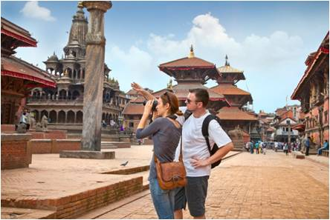
Interpretive guiding features
Key features of interpretive guiding
Provide a verbal commentary
Facilitate understanding
Give local and cultural context
Conduct appropriate and meaningful activities
Contextualise the tour and activities
Notes:
Discussion
Discuss these key features.

Slide 17

Interpretive guiding features
POETRY
One approach used for interpretive guiding is the acronym POETRY. This formula states delivery to tour groups must be:
P = Purposeful
O = Organised
E = Enjoyable or Engaging, or Entertaining
T = Thematic
R = Relevant to the audience
Y = You (the tour guide)
COMPLETE ACTIVITIES 1 & 2
Notes:
Discussion & Activity
Discuss the concept of POETRY
Complete Activities 1&2

Slide 18

Sources of information
Importance of having updated information
An essential aspects of conducting interpretive activities and providing accurate and informative content is to ensure that you are well versed in all aspects of:
General eco-tourism issues and considerations
Specific eco-tourism issues that apply to the region
Eco-tourism facts and figures pertaining to the focal areas in which the tour will be based around
Notes:
Discussion
What are examples of sources of information?

Slide 19

Sources of information
Sources of information
Relevant peak preservation and conservation bodies
Ministries of Tourism
Tourism Boards
Industry Authorities
Printed material
The general media
People from identified communities
Industry personnel
The internet
COMPLETE ACTIVITIES 3, 4, 5
Notes:
Discussion & Activities
What are examples of each source of information?
What information can be gathered from each?
Complete Activities 3,4,5

Slide 20

Understanding tour requirements
Identify requirements of the eco-tourism tour or activity to be conducted
Reading advertising or promotional materials
Reading the customer itinerary for the tour
Joining the tours already developed
Talking to other tour guides
Obtaining a copy of the script being currently used
Speaking with management
Notes:
Discussion
Discuss these requirements

Slide 21

Understanding tour requirements
Identify requirements of the eco-tourism tour or activity to be conducted
Using personal knowledge of the tour route
Reading feedback from past tour group members
Taking other tours provided by competitors or other tour operators
Speaking with organisational staff
Reading the contract for the tour
Talking to management
Notes:
Discussion
Discuss these requirements

Slide 22

Determine customer interests
Finding out needs of the customer
It is essential to talk to the customer to identify:
Their needs, wants and preferences
Critical aspects or topics which must be covered
Type or nature of the information required
Who the people in the tour group will be
Notes:
Discussion
How can you find out customer needs?

Slide 23
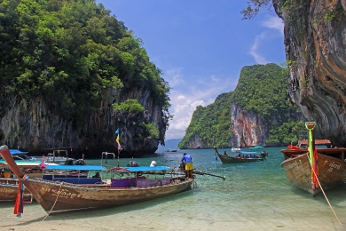
Determine customer interests
Examples of special requests
Timing
Budget
Location of the interpretive activity
Access to interpretive activities
Specific activities
Information
Level of engagement
Variations
Notes:
Discussion
What influences each of these special requests?
Use personal examples

Slide 24
Develop theme and message
Develop message
A ‘message’ underpins and supports the theme for an activity.
What are examples of messages for eco-tourism tours or activities?
Notes:
Discussion
Discuss the question in the slide

Slide 25
Develop theme and message
Develop theme
The ‘theme’ for the activity or the tour is often referred to as ‘the take home message’ for the visitors:
What are examples of themes for eco-tourism tours or activities?
Notes:
Discussion
Discuss the question in the slide

Slide 26

Develop theme and message
Considerations when developing themes
Support and align with identified objectives
Be approved
Integrate and align with the interpretive approach to guiding
Factor in the expected delivery environment
Comply with required and expected business principles and ethical standards
Notes:
Discussion
Discuss the importance of these considerations

Slide 27

Develop theme and message
Themes for interpretive activities
Flora, including types, history, concentrations, growth patterns, threats, seasonal influences, preservation and conservation issues
History and heritage of the general area with attention to special items or areas of interest
The general natural environment
The built environment, including its impact on the eco-system
Notes:
Discussion
What are examples of these themes in your region?
How can you create tours and activities based around these themes?

Slide 28

Develop theme and message
Themes for interpretive activities
Individual species, including their history, current context and predicted future, foods, predatory inclinations, habitats, mating habits, life cycle and threats
Specific geographic locations and landmarks
Feedback from customers and co-workers suggesting topics for activities
Initiatives recommended by local authorities and local communities
Topics of general community interest
COMPLETE ACTIVITY 6
Notes:
Discussion & Activity
What are examples of these themes in your region?
How can you create tours and activities based around these themes?
Complete Activity 6

Slide 29

Use research techniques to obtain information
Importance of conducting research
In order for interpretive activities and associated content to be effective there is a non-negotiable need for Tour Guides to research the subject that is the focus of the activity.
Why is this important?
How can you conduct research?
Notes:
Discussion
Discuss questions in the slide

Slide 30

Use research techniques to obtain information
Basic requirements for researched information
It is essential all facts and information obtained as a result of the research process align with the criteria which require them to be:
Relevant
Correct and accurate
Comprehensive
Current, where applicable
Notes:
Discussion
Explain the importance of these four points

Slide 31

Use research techniques to obtain information
Collect primary and secondary data
The two most common sources of data are:
Primary data – collected for a specific purpose
Secondary data – generic information
Notes:
Discussion
Explain the difference between these types of data.
Provide examples of both

Slide 32

Use research techniques to obtain information
Research options
Reading site and location specific information sources
Talking and listening to relevant people
Consulting with local communities
Organising information from personal memory and personal experiences
Monitoring the media
Notes:
Discussion
What are examples of each?
What are the benefits of using these research options?
What information can be obtained from each of these research options?

Slide 33
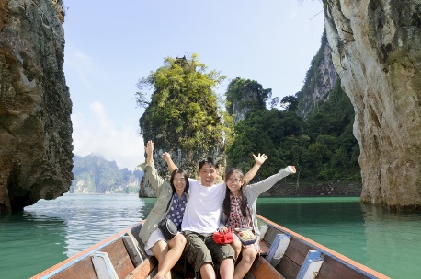
Use research techniques to obtain information
Research options
Undertaking internet desktop research
Touring and travelling
Joining groups & memberships
Notes:
Discussion
What are examples of each?
What are the benefits of using these research options?
What information can be obtained from each of these research options?

Slide 34

Use research techniques to obtain information
Keys in undertaking effective research
Ask questions
Make notes
Ensure the sources of all information are recorded
Read and review
Organise information for reference and research purposes
Notes:
Discussion
What is the importance of these points?

Slide 35

Use research techniques to obtain information
Keys in undertaking effective research
Validate the information gained
Obtain necessary permissions
Check back with the client
Update the research
COMPLETE ACTIVITY 7
Notes:
Discussion & Activity
What is the importance of these points?
Complete Activity 7

Slide 36

Classify and store information
Establish files and folders to record identified information
Once relevant information searched and identified, it must be filed for future use as deemed most appropriate by the enterprise and in-keeping with any relevant policies and procedures
Notes:
Discuss
How can information be stored / filed?

Slide 37

Classify and store information
Every tourism operator will have their own method of filing and storing information
Every office will have a system of filing all information so that it is easy to retrieve
Notes:
Discuss
Discuss importance of having appropriate inventory storage system

Slide 38

Classify and store information
Options for storing information
Information inventory systems may be:
Manual filing systems
Computerised systems
Combination of the above
Notes:
Discuss
Provide examples of each systems

Slide 39

Classify and store information
Considerations when storing information
Timing of data entry and up-dates, including up-date schedules
Authorities to enter data, including designation of individuals and positions within the business
Identification of specific data that must and must not be entered onto the system
Complying with operational requirements of the data system
Version controls to note dates material was last edited/up-dated
Notes:
Discuss
Discuss importance of these considerations?

Slide 40

Classify and store information
Classifying information
The process of classifying information includes:
Preserving actual samples
Organising facts into discrete sections
Arranging information under nominated headings
Ordering statistics in date or time sequence
Contrasting one set of data to another set for the purposes of comparison
Grouping similar facts and details
Indexing the information obtained
COMPLETE ACTIVITY 8
Notes:
Activity
Complete Activity 8

Slide 41

Verify information
Importance of verifying information
Once you have captured information that has been collect or given to you by various sources and organisations it is now time to review and verify the information and determine its importance, accuracy and relevancy for tours to be conducted:
Why is this important?
How can you do this?
What are the objectives of reviewing and verifying captured information?
Notes:
Discuss
Discuss questions in the slide

Slide 42

Verify information
Purpose of interpreting information
Gaining further understanding of the information
Identifying any questions you may have
Identify the key points in which you may convey to stakeholders, colleagues or clients
COMPLETE ACTIVITY 9
Notes:
Class Activity – Discuss & Activity
Why is this important?
Complete Activity 9

Slide 43

Learn required information
Why the need to gather and learn more information?
Based on the process of verifying and interpreting information, further information may need to be gathered:
Why is this required?
Notes:
Class Activity – Discuss
Discuss the question in the slide

Slide 44

Learn required information
Need to gather and learn extra information
Paint more context for the tour
Describe additional features and information
Answer questions asked by tour group members
Provide extra detail emerging as required for individual parties
Demonstrate professionalism
Notes:
Class Activity – Discuss
Discuss the importance of these points, providing personal examples.

Slide 45

Learn required information
Need to gather and learn extra information
Help build personal credibility
Promote certain businesses, activities or regions associated with the tour
Expand on information supplied as part of the scripted commentary
Meet tour party expectations by satisfying individual need
Notes:
Class Activity – Discuss
Discuss the importance of these points, providing personal examples.

Slide 46

Learn required information
Ways to learn extra information
Actively studying the material generated
Conducting test activities
Writing additional scripts
Creating alternate presentation options
Updating personal knowledge
COMPLETE ACTIVITY 10
Notes:
Class Activity – Discuss & Activity
Discuss the importance of these points, providing personal examples.
Complete Activity 10

Slide 47

Element 2:
Prepare an eco-tourism activity
Notes:
Introduce topic.
Class Activity – General Discussion
Ask general questions:
What is a ‘eco-tourism’ activity?
What are the steps associated with preparing a tour or activity?

Slide 48
Prepare an eco-tourism activity
Performance Criteria for this Element are:
Develop and determine concepts, themes and focal points for potential eco-tourism activities
Acquire physical resources to support identified eco-tourism concepts, themes and focal points
Generate scripted commentaries to support identified eco-tourism concepts, themes and focal points
Notes:
Trainer identifies the Performance Criteria for this Element, as listed on the slide.

Slide 49
Prepare an eco-tourism activity
Performance Criteria for this Element are:
Trial developed eco-tourism activities for identified concepts, themes and focal points
Revise developed eco-tourism activities on the basis of feedback
Promote prepared eco-tourism activities
Notes:
Trainer identifies the Performance Criteria for this Element, as listed on the slide.

Slide 50

Develop eco-tourism activities
Key points of determining and creating activities
Prioritising options that have been identified
Evaluating practicality of implementing available options, including impact, cost, sensitivity, timing, safety and sustainability issues
Planning physical and ancillary requirements to deliver selected options
Setting specific objectives for each eco-tourism activity
Notes:
Class Activity – Discuss
Discuss the importance of these points

Slide 51

Develop eco-tourism activities
Objectives of interpretive activities
Possible objectives for the tour group can include:
Education
Experience
Relaxation
Fun
Excitement
Celebration of an event/historical date
Money raising
Recreation
Notes:
Class Activity – Discuss
Identify examples of these objectives for tours or activities currently being offered.
What are other examples of objectives?

Slide 52
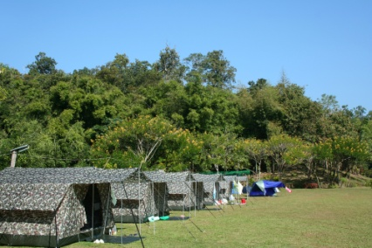
Develop eco-tourism activities
Setting objectives for each eco-tourism activity
Specific objectives for interpretive activities may relate to:
Educational, historical or cultural issues
Commercial imperatives
Social agendas
Content of the tour
Compliance requirements
COMPLETE ACTIVITY 11
Notes:
Class Activity – Discuss & Activity
What are considerations for each of these points?
Complete Activity 11

Slide 53
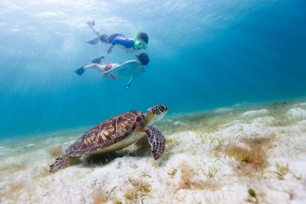
Develop eco-tourism activities
Developing interpretive activities
When the themes and messages for an interpretive activity have been identified the next stage of development is to generate the specific activities which will be used to deliver the experience:
What are examples of activities that can be used to support themes and objectives?
What are considerations when selecting interpretive activities
Notes:
Class Activity – Discuss
Discuss questions in the slide

Slide 54
Develop eco-tourism activities
Types of interpretive activities
Guided site activities, including interactive and static displays
Touring activities
Commentaries
Problem solving activities
Concept testing activities
Spotting and observation activities
Any activity that facilitates engagement with the subject that is the focus of the activity
Notes:
Class Activity – Discuss
What are examples for each these activities used in your region?

Slide 55
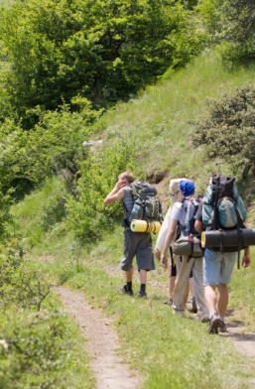
Develop eco-tourism activities
Types of interpretive activities
Conducting role plays
Story telling
Games
Demonstrations
Interpretive walking tours
Participant interaction
Sensory awareness exercises
Use of materials
Use of technology
Notes:
Class Activity – Discuss
What are examples for each these activities used in your region?

Slide 56
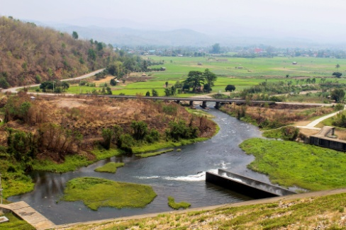
Develop eco-tourism activities
Planning interpretive activities
Type of activity
Staff who may deliver it
Resources available
Resources required
Time required for planning and implementation
Audience numbers
Notes:
Class Activity – Discuss
Discuss these steps using an existing tour or activity as a guide

Slide 57
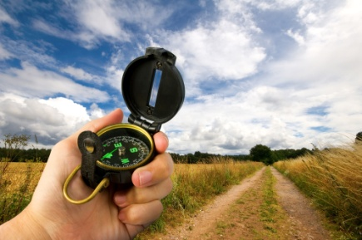
Develop eco-tourism activities
Identify detailed description of activity
Sequencing of element
Timing
Suggested introduction
Actions to be undertaken by presenter
Central points to be raised
Matters which cannot be shared
Agreed involvement of local communities
Activities anticipated by tour group members
Central aspect of the activity
Notes:
Class Activity – Discuss
What other points need to be detailed?

Slide 58

Develop eco-tourism activities
Using specialist personnel
In some cases those with responsibility for developing an interpretive activity may be able to involve a range of specialist personnel in the development phase.
What are examples of:
Subject matter experts
Cultural advisers
Technical advisors and experts
Environmental educators
Interpretive consultants
Notes:
Class Activity – Discuss
Discuss the question in the slide
What help can they provide?

Slide 59
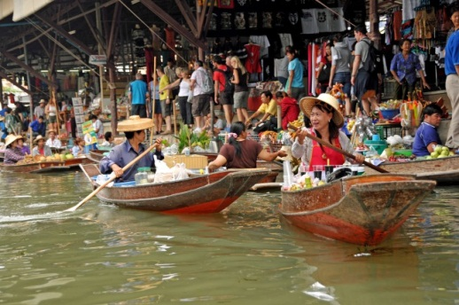
Develop eco-tourism activities
Involve local community participation
Employing or engaging local people in nominated roles
Capitalising on retail opportunities
Increasing levels of public exposure for issues
Chance to redress public misconceptions
COMPLETE ACTIVITY 12
Notes:
Class Activity – Discuss & Activity
How else can you involve the local community in tours or activities?
Complete Activity 12

Slide 60

Acquire physical resources
Importance of identifying required resources
When interpretive activities have been authorised for inclusion as part of a tour there will be a need to develop materials and resources to enable and support the delivery of the activity when on-tour:
What are examples of resources that can be used in a tour or activity?
Notes:
Class Activity – Discuss
Discuss the question in the slide

Slide 61
Acquire physical resources
Importance of identifying required resources
Cross-check requirements against supply
Determine financial parameters/budget
Ensure all required resources are prepared and loaded for the tour or activity
Notes:
Class Activity – Discuss
What are other reasons for identifying resources?

Slide 62
Acquire physical resources
Types of resources required to deliver interpretive activities
Financial resources
Human resources
Materials
On-tour documents
Activity-related physical resources
Presentation equipment
COMPLETE ACTIVITY 13
Notes:
Class Activity – Discuss & Activity
What are examples for each category of resources?
Complete Activity 13

Slide 63

Acquire physical resources
Development or acquisition resources
Materials and physical resources may need to be:
Developed
Acquired
What is the difference?
Notes:
Class Activity – Discuss
Discuss the question in the slide

Slide 64

Acquire physical resources
Development of resources
Researching what is required
Preparing materials
Writing handouts, scripts, instructions and information
Making a film/DVD
Generating things ‘from scratch’
Modifying existing resources
Notes:
Class Activity – Discuss
What are the advantages and disadvantages of this option?

Slide 65
Acquire physical resources
Acquiring resources
Buying resources from a third party
Borrowing resources from someone or another business
Sharing the cost of purchase between other Tour Operators
Asking others to donate items
Notes:
Class Activity – Discuss
What are the advantages and disadvantages of this option?

Slide 66

Acquire physical resources
Acquiring resources
Hiring items
Using resources which already exist within the business
Being given resources, items or materials from local communities or government agencies
COMPLETE ACTIVITY 14
Notes:
Class Activity – Discuss & Activity
What are the advantages and disadvantages of this option?
Complete Activity 14

Slide 67

Acquire physical resources
Obtaining necessary permits
It is essential that the permissions and authorisations for the tour and for each activity are obtained:
What permits are required to conduct eco-tourism activities in your region?
COMPLETE ACTIVITY 15
Notes:
Class Activity – Discuss & Activity
Discuss question in the slide
Complete Activity 15

Slide 68

Generate scripted commentaries
Importance of commentaries
One of the main features of providing 'interpretive content' is to have commentary to support activities.
All tour commentaries should be:
Well thought out, accurate
Entertaining
Containing all essential information to help customers understand and enjoy the tour and associated activities
Notes:
Class Activity – Discuss
What are examples of commentaries you have enjoyed in the past?
What made them enjoyable?

Slide 69

Generate scripted commentaries
Benefits of commentary scripts
They allow the quick and efficient communication of information and facts
They can be used to reinforce and remind tour group members of detail and data pertinent to an activity
They can be pre-planned and practiced
They are expected
They are inexpensive
Notes:
Class Activity – Discuss
What other benefits exist?

Slide 70

Generate scripted commentaries
Considerations when preparing commentary scripts
Identify the commentary information that needs to be conveyed
Research the selected commentary information that needs to be conveyed
Obtain copies of sample tour commentary scripts
Talk to other Tour Guides
Classify commentary information
Notes:
Class Activity – Discuss
Discuss these considerations

Slide 71
Generate scripted commentaries
Considerations when preparing commentary scripts
Develop themes for the commentary information
Prepare draft scripts for commentary information that needs to be conveyed
Learn supporting information
Implement the scripted commentary
Notes:
Class Activity – Discuss
Discuss these considerations

Slide 72

Generate scripted commentaries
Principles for writing commentary scripts
Realising the creation of a good scripted commentary for a tour takes time
Ensuring currency and accuracy of content
Ensuring comprehensive and relevant information
Including necessary safety and security information
Ordering the information in logical sequence
Preparing sufficient information
Notes:
Class Activity – Discuss
Discuss these principles including their importance

Slide 73

Generate scripted commentaries
Principles for writing commentary scripts
Choosing and using appropriate language
Matching the length of the script
Providing an appropriate mix of Quantitative and Qualitative information
Writing the script from the tour group members’ perspective
Involving others in the writing of the script
Identify the commentary for the tour and each interpretive activity
COMPLETE ACTIVITY 16
Notes:
Class Activity – Discuss & Activity
Discuss these principles including their importance
Complete Activity 16

Slide 74

Trial developed eco-tourism activities
Conducting eco-tourism activities
Once all the elements of a eco-tourism activity have been identified, it is now time to:
Plan
Implement
Monitor
Review
the interpretive activity.
Notes:
Class Activity – Discuss
What activities are associated with each of these steps?

Slide 75

Trial developed eco-tourism activities
Trial eco-tourism activities
These may include:
Undertake planning of eco-tourism activities
Conducting the eco-tourism activities as planned, including all activities and commentaries
Including participants and observers for the trial
Ensuring the trial reflects expected actual tour conditions for the activity
Recording the trial for later analysis or review
Notes:
Class Activity – Discuss
What activities are associated with each of these steps?

Slide 76
Trial developed eco-tourism activities
Undertake planning of eco-tourism activities
Consideration of planning needs may embrace:
Consideration of the timing
Consideration of the weather
Consideration of the physical resources
Notes:
Class Activity – Discuss
What are considerations for each of these points?

Slide 77
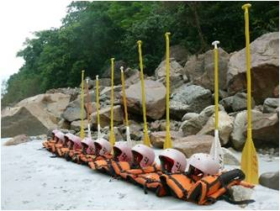
Trial developed eco-tourism activities
Prepare interpretive activity requirements
Setting up an interpretive activity can involve the following generic actions:
Obtaining resources
Inspecting the condition of equipment and other items
Obtaining handout materials, equipment and other physical resources
Checking the activity area
Holding a briefing
COMPLETE ACTIVITY 17
Notes:
Class Activity – Discuss & Activity
What are requirements are there?
Complete Activity 17

Slide 78
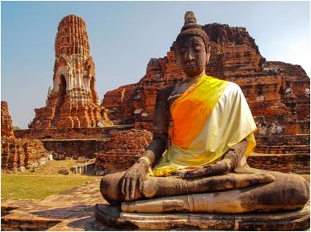
Trial developed eco-tourism activities
Respect local communities
At all times the Tour Guide must ensure there is respect shown for local communities.
Practical aspects of this requirement may include:
Meeting with local communities to develop Codes of Practice and other working agreements
Developing Codes of Conduct
Notifying communities in advance
Maintaining regular contact with local communities
Providing economic opportunity for host communities
Notes:
Class Activity – Discuss
What are examples you can do for each of these points to help respect the community?

Slide 79
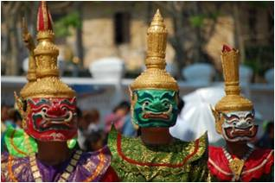
Trial developed eco-tourism activities
Respect local communities
Advising the communities before the tour
Notifying tour group members of acceptable and unacceptable conduct
Asking permission to enter lands or communities
Observing the necessary cultural constraints
Maintaining secrecy of items and information
Involving the host community in decision making which impacts them
Notes:
Class Activity – Discuss
What are examples you can do for each of these points to help respect the community

Slide 80

Trial developed eco-tourism activities
Respect local communities
Parking only in designated areas
Staying on designated walking tracks and agreed pedestrian routes
Prohibiting taking of photographs
Banning use of limited local resources
Identifying and banning carriage of nominated items onto community property
Cleaning up after using facilities
Modifying tours and interpretive activities
COMPLETE ACTIVITY 18
Notes:
Class Activity – Discuss & Activity
What are examples you can do for each of these points to help respect the community?
Complete Activity 18

Slide 81

Trial developed eco-tourism activities
Ensure safety issues are addressed
A vital part of the preparation for an on-tour activity is the need to ensure all safety issues have been addressed:
Duty of Care
General safety and security
Emergency equipment
Safety equipment
COMPLETE ACTIVITY 19
Notes:
Class Activity – Discuss & Activity
What are examples of safety requirements and considerations for each of these points?
Complete Activity 19

Slide 82
Trial developed eco-tourism activities
Conduct briefings with staff
Roll call
Provision of an overview of the activity
Confirmation the activity should proceed
Discussion of duration for the activity
Development or confirmation of arrangements to address issues arising
Allocation of staff to required positions
Verification of the presence of physical resources
Conduct of communication checks
Notes:
Class Activity – Discuss
What information would need to be explained under each point?
What else would need to be explained or communicated with staff conducting tours or activities?

Slide 83
Trial developed eco-tourism activities
Key points of interpretive activity to explain
Making verbal group-based announcements
Provide a welcome
Including them on the itinerary
Presentation of site-specific Code of Conduct
Notifying of basic operational parameters
Introducing other staff who will assist the Tour Guide
Distributing materials, resources or equipment
Notes:
Class Activity – Discuss
What information would need to be explained under each point?
What else would need to be explained or communicated with customers at the start of a tour or activity?

Slide 84

Trial developed eco-tourism activities
Key points of interpretive activity to explain
Demonstrating use of items required in relation to the activity
Assessing individual capacity for individual tour group members to participate in the activity
Encouraging tour group members to engage with the activity
Responding to questions and concerns
Speaking to people on an individual basis
Notes:
Class Activity – Discuss
What information would need to be explained under each point?
What else would need to be explained or communicated with customers at the start of a tour or activity?

Slide 85

Trial developed eco-tourism activities
Using recorded introductions
Some tours and activities feature the use of recorded ‘introductions’:
When would they be used?
How can this information be communicated with customers?
Notes:
Class Activity – Discuss
Discuss questions in the slide

Slide 86
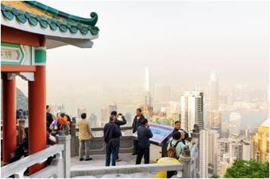
Trial developed eco-tourism activities
Explaining interpretive activities
After tour group members have been formally introduced to the interpretive activity, the activity must be explained to them:
What do customers need to know?
How would your explain activities?
Notes:
Class Activity – Discuss
Discuss questions in the slide

Slide 87
Trial developed eco-tourism activities
Communication techniques
Repeat parts of the commentary
Be prepared to paraphrase what has already been said
Speak at a different pace
Use plenty of pointing and hand gestures
Interact with the group
Notes:
Class Activity – Discuss
What is the purpose and importance of these communication techniques?
What other communication tips would you use?

Slide 88

Trial developed eco-tourism activities
Communication techniques
Be constantly alert to barriers to communications
Common barriers are noise and line-of-sight obstacles.
Check for understanding of what has been said
Use extra staff
Address emotional barriers
Notes:
Class Activity – Discuss
What is the purpose and importance of these communication techniques?
What other communication tips would you use?

Slide 89
Trial developed eco-tourism activities
Demonstrate activity pre-requisites
Implementing approved plans for demonstration of the interpretive activity
Distributing equipment
Integrating explanations with demonstrations
Using the tour team to conduct a simulated activity
Focusing on the standard presentation technique for demonstrations
Notes:
Class Activity – Discuss
What is the purpose and importance of these demonstrative points?

Slide 90
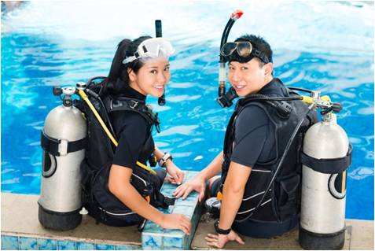
Trial developed eco-tourism activities
Demonstrate activity pre-requisites
Walking the activity ground
Distributing activity-related items if required
Distributing safety equipment
Showing how to use equipment
Showing use of PPE
Showing how to use emergency equipment
Employing the services of ‘sufficient’ personnel
Allocating sufficient time for the demonstrations
Notes:
Class Activity – Discuss
What is the purpose and importance of these demonstrative points?

Slide 91
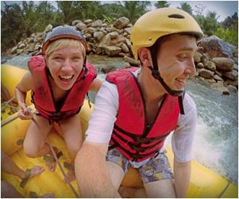
Trial developed eco-tourism activities
Confirm customer understanding of upcoming activity
A vital part of the explanation and demonstration phase is the need to ensure tour group members understanding of requirements:
Why is it important to confirm understanding?
What methods can be used to check understanding?
Notes:
Class Activity – Discuss
Discuss the questions in the slide

Slide 92

Trial developed eco-tourism activities
Provide interpretive commentary
Conduct of interpretive activities will traditionally require the provision of commentary and the use of a range of interpretive presentation techniques.
All tours will require some form of commentary:
Commentary may be described as:
Scripted
Unscripted
Notes:
Class Activity – Discuss
What is the difference?
When are each type of commentary best used?

Slide 93

Trial developed eco-tourism activities
Advice on delivering scripted commentary
Ensuring visibility to all tour group members
Facing the group
Speaking loudly enough for everyone to hear
Remaining enthusiastic and appropriate to the nature and content of the activity
Beginning the verbal commentary sufficiently in advance of a scheduled event
Focusing attention on entire group
Notes:
Class Activity – Discuss
Why are these points important?

Slide 94

Trial developed eco-tourism activities
Advice on delivering scripted commentary
Communicating at level that will be understood by the audience
Encouraging questions
Making the commentary a ‘unique’ event
Knowing when to be quiet
Adjusting the commentary as required
Notes:
Class Activity – Discuss
Why are these points important?

Slide 95

Use prepared aids and materials
Hard copy items
Safety tips
Information handouts
Rules of the game
Permanent take home copy of the commentary
Maps
Diagrams
Photographs
Sight cards
Activity sheets
Exercise sheets
Question sheets
Score cards
Notes:
Class Activity – Demonstrate and Discuss
Trainer to show examples of these hard copy items
Explain when they best would be used.

Slide 96
Use prepared aids and materials
Activity-related physical resources
Sports gear
Props
Costumes
Equipment and items specific to the individual nature and need of particular activities
Special needs gear
Natural resources
Notes:
Class Activity –Discuss
What are examples for each type of resource?
When would they best be used?

Slide 97
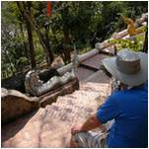
Use prepared aids and materials
Human resources
Sufficient observers
Performers and actors
Players, teams and troupes
Presenters and demonstrators
Guest speakers
Assistants
Involvement of special interest organisations and groups
Notes:
Class Activity –Discuss
What are examples for each type of human resource?
When would they best be used?

Slide 98
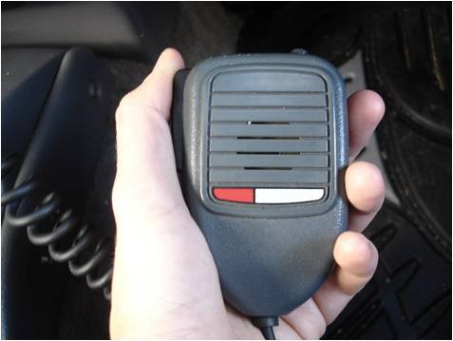
Use prepared aids and materials
Equipment and technology
PA systems and microphones
Megaphones
Overhead projectors
Data projectors
Slides and transparencies
Sound and lighting technologies
Laser pointers
Personal electronic devices
COMPLETE ACTIVITY 20
Notes:
Class Activity –Discuss & Activity
What are examples for each type of resource?
When would they best be used?
Complete Activity 20

Slide 99
Anticipate issues
Anticipate issues
All Tour Guides need to consider ‘issues arising’ during the conduct of the tour when they schedule an interpretive activity:
What are examples of issues?
How do you identify them?
How do you resolve them?
COMPLETE ACTIVITY 21
Notes:
Class Activity –Discuss & Activity
Discuss questions in the slide
Complete Activity 21

Slide 100

Revise eco-tourism activities
Importance of conducting review and evaluation
Once the trial interactive activity has taken place, it is now time to review and evaluate the success of the trial and to make recommendations for future success.
All interpretive activities need to be reviewed and evaluated as part of standard operating procedures.
What is the difference between a review and evaluation?
Why are they important to do?
How can they be done?
Notes:
Class Activity –Discuss
Discuss questions in the slide

Slide 101

Revise eco-tourism activities
Purpose of conducting a review and evaluation
Determine if the activities are effective
Assess whether or not the activities remain relevant
Identify satisfaction levels of tour group members
Work out the extent to which the activities ‘as delivered’ in reality match expectations
Calculate the cost of conducting the activities
Meet quality assurance obligation
Provide current and actual data to management
Confirm all management protocols remain valid and effective
Notes:
Class Activity –Discuss
Why is this important?

Slide 102

Revise eco-tourism activities
Evaluate actual presentation of the interpretive activity against target performance criteria
A standard element of many evaluations is to consider the extent to which each interpretive activity achieved its projected performance objectives.
These are referred to as ‘Performance criteria’
What are examples of performance criteria?
COMPLETE ACTIVITY 22
Notes:
Class Activity –Discuss & Activity
Identify types of performance criteria as asked in the slide.
Complete Activity 22

Slide 103

Revise eco-tourism activities
Conducting review and evaluation activities
Holding meetings
Reviewing customer feedback
Distributing feedback forms
Encouraging feedback
Interviewing stakeholders face-to-face
Notes:
Class Activity –Discuss
What is the purpose of each of these activities?

Slide 104

Revise eco-tourism activities
Conducting review and evaluation activities
Observing implementation of activities in order to record required data
Entering data into the system for analysis
Determining whether or not more data needs to be obtained or if current data requires clarification
Assessing and analysing the information against the objectives set for the review process
Notes:
Class Activity –Discuss
What is the purpose of each of these activities?

Slide 105
Revise eco-tourism activities
Evaluate actual presentation of the interpretive activity against target performance criteria
A standard element of many evaluations is to consider the extent to which each interpretive activity achieved its projected performance objectives:
These are referred to as ‘Performance criteria’
What are examples of performance criteria?
Notes:
Class Activity –Discuss
Identify types of performance criteria as asked in the slide.

Slide 106

Revise eco-tourism activities
De-brief with colleagues
De-briefing occurs after an event and is undertaken to capture feedback on:
What happened
What could be improved
Problems
Notes:
Class Activity –Discuss
Who attends a de-brief?

Slide 107

Revise eco-tourism activities
De-briefings may be supported by:
Paper-based or electronic reports
Formal meetings
Input from relevant others/third party partners
Notes:
Classroom Activity – Handout
Trainer distributes and discusses sample staff feedback forms/reports.

Slide 108
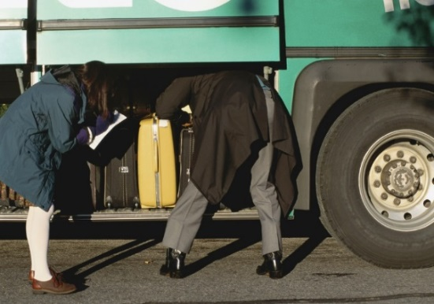
Revise eco-tourism activities
Types of colleagues
Colleagues who may be involved in de-briefings:
Tour Guides
Drivers
Internal sales, counter, ticketing staff
Agents and partners
Presenters and performers
Notes:
Classroom Activity – Guest Speakers
Trainer arranges for a range of colleagues identified on slide to attend and:
Discuss importance of de-briefings
Explain their roles in de-briefings
Identify examples of issues which are raised and resolved
Describes when, where and how they take place.

Slide 109

Revise eco-tourism activities
Activities in de-briefings
Soliciting verbal feedback
Obtaining written feedback
Analysing written reports
Evaluating staff perceptions
Considering known complaints
Advising of upcoming tours/activities
Thanking staff
Notes:
Class Activity –Discuss
Discuss the importance of these activities

Slide 110

Seek feedback from customers
Methods and timing of customer feedback
Noting the body language of people
Listening to what tour group members say
Soliciting written feedback
Surveys or Response Sheets
Targeted questionnaires
Focus groups
Analysing comments made by and input received from third party providers
Notes:
Class Activity –Discuss
How else can you get customer feedback?

Slide 111

Revise eco-tourism activities
Identifying revisions to interpretive tours or activities
It is important revisions to be made to tours or activities are based on evidence as revealed by the evaluation:
What are revisions necessary?
What are the benefits of making revisions?
What types of revisions can be made to tours and activities?
Notes:
Class Activity –Discuss
Discuss the questions in the slide

Slide 112

Revise eco-tourism activities
Types of revisions
Altering plans
Acquiring extra or different resources
Acquiring extra information
Preparing revised or new activities
Generating revised or new commentaries
Incorporate new knowledge in existing activities
Notes:
Class Activity –Discuss
Provide examples of where these revisions have been implemented.

Slide 113

Revise eco-tourism activities
Types of revisions
Changing the basic tenor of an activity
Altering the pacing of the presentation
Changing the scope of the activity itself
Adjusting the duration of the activity
Addressing the degree of engagement and participation of the tour group
Altering the level of communication and interaction with individuals
Taking action in relation to the administration of the activity
Notes:
Class Activity –Discuss
Provide examples of where these revisions have been implemented.

Slide 114

Revise eco-tourism activities
Types of revisions
Moving the location of the activity
Responding to changing environmental and other factors
Abandoning planned activities and initiating a substitute alternative activity
Changing the promotional activities for the tour
Amending staffing for the tour
Changing parameters relating to tour customers
Notes:
Class Activity –Discuss
Provide examples of where these revisions have been implemented.

Slide 115

Promote prepared eco-tourism activities
Promoting activities
After all planning, preparation and trails for interpretive activities have been completed there can be a need to promote both the tour and the activities:
How can you promote a tour or activity?
Notes:
Class Activity –Discuss
Discuss the question in the slide

Slide 116

Promote prepared eco-tourism activities
Promotional considerations
Adhere to budget
Target intended customers
Use language appropriate to each target market
Leverage joint/co-promotions
Time the promotion ‘correctly’
Use a variety of options
Use a promotion plan
Update/revise advertising, as required
Notes:
Class Activity –Discuss
What other considerations would you have?
How do you address these considerations?

Slide 117

Promote prepared eco-tourism activities
Types of promotional activities
Writing advertisements
Designing promotional materials
Selecting media
Supplying media releases to the media
Conducting media events
Inviting agents to participate
Notes:
Class Activity –Discuss
When would you use these promotional activities?

Slide 118

Promote prepared eco-tourism activities
Types of promotional activities
Providing free tours, travel and accommodation to the media
Creating merchandise to support the tour or attraction
Allocating resources to support the promotion
Distributing promotional materials to targeted outlets
Participating in a variety of shows
Using a range of personalities to sell the message
COMPLETE ACTIVITY 23
Notes:
Class Activity –Discuss & Activity
When would you use these promotional activities?
Complete Activity 23

Slide 119

Element 3:
Update knowledge and ecotourism activities
Notes:
Introduce topic.
Class Activity – General Discussion
Ask general questions:
Why is it important to update your industry knowledge?
How can you do it?
Who can you share this information with?
How can information be shared?

Slide 120

Update knowledge and ecotourism activities
Performance Criteria for this Element are:
Take action to receive information from relevant bodies
File and share new information
Incorporate new knowledge in existing activities
Create new activities
Correct information and activities that prove to be inaccurate or misleading
Notes:
Trainer identifies the Performance Criteria for this Element, as listed on the slide.

Slide 121

Updating eco-tourism industry knowledge
Importance of updating industry knowledge
It is important to be up-to-date with the ever changing industry, especially in relation to eco-tourism trends and developments
This might mean that you have to find out information about a particular eco-tourism topic, location, attraction, trend or customer preference
Notes:
Class Activity –Discuss
Discuss the importance of updating industry information

Slide 122

Updating eco-tourism industry knowledge
Areas to monitor
New eco-tourism developments
New topics for discussion
New laws and regulations relating to eco-tourism in your region
New eco-tourism related products, services, tours and activities
Trends and selling prices of the products and services being offered by your business and competitors
Notes:
Class Activity –Discuss
How can you monitor these areas?
What information would you like to know?

Slide 123

Updating eco-tourism industry knowledge
Areas to monitor
Activities the opposition is undertaking to attract customers or to meet competition in the market place
Changing and emerging trends
New techniques and workplace practices
New equipment and technology
Initiatives relating to advertising, marketing and promotion
Market research information
Notes:
Class Activity –Discuss
How can you monitor these areas?
What information would you like to know?

Slide 124

Monitor current issues of concern
Causes of issues of concern
The state of the economy
Eco-tourism practices
Environmental considerations and concerns
Terrorism
Customer confidence
Weather
Technological and legislative changes that impact on the industry
COMPLETE ACTIVITY 24
Notes:
Class Activity –Discuss & Activity
How can you monitor these concerns?
What impacts or influences these issues for concern?
What information would you like to know?
Complete Activity 24

Slide 125

Updating eco-tourism industry knowledge
Methods to update industry knowledge
Formal and informal research
Media
Reference books
Industry associations and organisations
Industry journals
Personal experience
Educationals
Functions
On-the-job
Taking the time to visit the opposition
Notes:
Class Activity –Discuss
What are the benefits of using each of these methods?

Slide 126

Updating eco-tourism industry knowledge
Establishing industry networks
Developing your own industry network
Networking with industry colleagues
Attend conferences and seminars
COMPLETE ACTIVITY 25
Notes:
Class Activity –Discuss & Activity
What are the benefits of establishing industry networks?
What organisations would you like to invite to a network?

Slide 127

Updating eco-tourism industry knowledge
Contact information services
E-newsletters
Fact Sheets
Updates
Guides
Information Sheets
Over-the-phone advice from inspectors, field officers or other appropriate personnel within the agency
Notes:
Class Activity –Discuss & Activity
What are examples of organisations that provide these information services for the eco-tourism industry?

Slide 128

Updating eco-tourism industry knowledge
Registering for information
Registering for industry information may include:
Registering on-line
Paying a fee
Establishing required password and username, if required
Lodging host enterprise details with product information source
Establishing the bona fides of the host enterprise
Joining an association or body
COMPLETE ACTIVITY 26
Notes:
Class Activity – Activity
Complete Activity 26

Slide 129

Sharing information
Importance of sharing information
When you have managed to gather updated information, knowledge or skills you must be prepared to share that information and incorporate it into you day-to-day work activities:
Who should you share information with?
What information do they need to know?
Notes:
Class Activity –Discuss
Discuss the questions in the slide

Slide 130
Sharing general information
Sharing general industry knowledge
One-on-one basis discussions
Staff briefings or meetings
E-mail
Prepare a short handout
Preparing posters to share the information
Producing handouts
Notes:
Class Activity –Discuss
What other methods can

Slide 131
Sharing general information
Incorporating knowledge into everyday practice
Working in accordance with new or revised requirements
Using new knowledge to modify personal work practices
Updating printed materials
Supplying information to customers that incorporate the new knowledge
Notes:
Class Activity –Discuss
Provide examples of how information can be incorporated into everyday practice

Slide 132

Sharing specific tours and activities information
Sharing specific tours and activities information
As mentioned, whether in the course of normal operations or due to changes made to tours and activities, information must be communicated with a wide range of vested stakeholders:
What are examples of ‘invested stakeholders’?
Notes:
Class Activity –Discuss
Discuss the question in the slide

Slide 133

Sharing specific tours and activities information
Types of stakeholders
Host communities
Tour operator employees who are also part of the tour group
Third party providers, joint venture partner and agencies
Local and independent guides
Designated contacts at destinations, suppliers and venues
Land owners and land managers
Representatives of statutory authorities
Notes:
Class Activity –Discuss
Identify types of people under each category

Slide 134

Sharing specific tours and activities information
Nature of communication with stakeholders
Responding to requests from colleagues for assistance
Asking them for assistance
Liaising with individuals and properties
Providing support for the work of others
Anticipating requests from colleagues
Communicating with venues, sites, destinations and providers
Making payment for services and products
COMPLETE ACTIVITY 27
Notes:
Class Activity –Discuss & Activity
Identify types of communication under each category
Complete Activity 27

Slide 135

Finish:
Thank you!
Notes:
This is the conclusion of the subject.
Thank the audience and deliver assessments as required.

